Slide 1

International Trade & Economic freedom
University of Miami Data Analytics Project II
Presented by:
Leyre Chico
Elisabett Rico
Andre Spaulding

Slide 2

Contents
Project Charter
Process and Milestones
Methodology for Data Management
Development Process
Utilization of Data Science tools
Jupyter Notebook and PgAdmin
.CSV Files
Excel
Conclusion and Project II Results

Slide 3
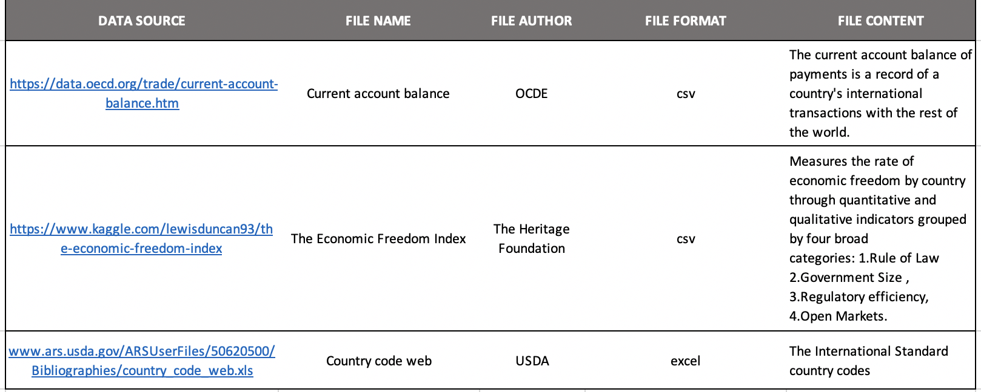

Project ii charter
For our second project we were tasked with creating a project that followed the ETL (Extract, Transform & Load) Methodology covered in class. Our team is passionate about financial data therefore, this led us to look for data sets which involved the measurement of economic freedom in the Global Economy. We also searched for years of country’s Trading Balances to see if there was a correlation between the degree of economic freedom and a country having a high trading balance. As a result, our targeted search for relevant data sources on Google and Kaggle produced the two data sets below:
Once we retrieved the data, we performed the ETL process of extracting, cleaning and transforming the data frames, and loading the data into pgAdmin. Then we performed statistical analysis and drew conclusions.

Slide 4
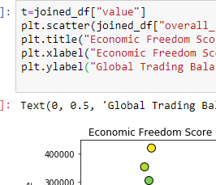
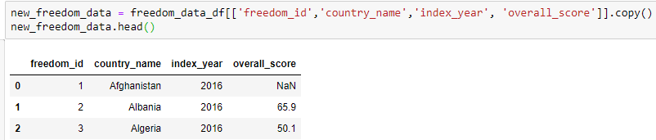
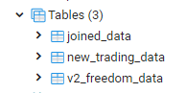
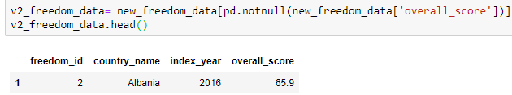
ETL Project Process and Milestones
Research & Data Gathering
Discussion of project topic
Data Extraction & Cleansing
Uploaded both files into Jupyter notebook
Load Data Frames into pgAdmin
A Data Base for this project was created in pgAdmin along with Data Tables for the two Jupyter Notebook Data Frames
Search for relevant data in Kaggle and the online census data
Created unique data frames from original csv’s with applicable data
Removed all nulls from the data
Joined the World Trading Balance data source with a data source containing a dictionary of Country code to country name to pull in the country name to the data frame
Connected to pgAdmin from Jupyter Notebook to connect the data frames to the data tables
Confirmed in Jupyter Notebook that the data had been added to the Tables by querying the two Tables
Analyze Data & Make Conclusions
Joining the two data frames in Jupyter Notebook we created Scatter plots to see if there was a correlation between the Economic Degree of Freedom
Found a list of Country’s Economic Degrees of Freedom over time and The world trading balance over time listed by Country Code

Slide 5
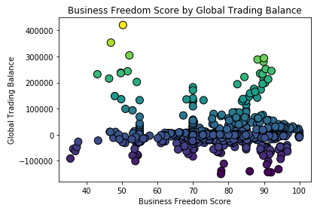
Global Accounting by Country
Global Payment Ranking (Business)
This graph illustrates the account balance of payments which is a record of the country’s international transactions with the rest of the world graphed against the Business freedom score element of the economic degree of freedom. Many countries pay their bills on-time. but you can see from the graph that there are few outliers
Lower Range outlier: This outlier be attributed to large balances on loans
Higher Range outlier: This outlier can be attributed to a large spend with heavy manufacturing.
Analysis: Many of these grouped near or below zero tend to pay their bills on time but there is a minimal amount of trade and growth in these areas. Countries that have a higher business freedom score (ability of the government to regulate business), from 80 – 90, also have a higher trade balance. However, the correlation coefficient was negative : -0.02, which is insignificant

Slide 6
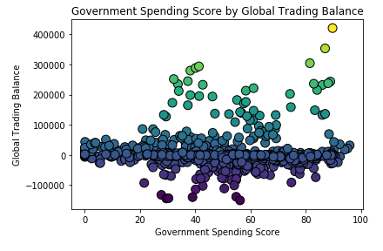
Global Accounting by Country (cont.)
Global Payment Ranking (Government)
The graph depicts the government spending score aspect of the economic freedom score against the global trading balance
The government spending score considers government expenditures as a percentage of gdp
Analysis: There appears to be a slight positive trend. However the correlation coefficient was 0.041, which is insignificant.

Slide 7
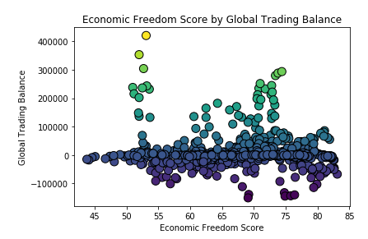
Economic Freedom by Country
Economic Freedom (Table Join)
The economic freedom of a country is the measure of people within a society to take economic measures. This is calculated through the measure of various elements, such as those listed in above slides (see pg. 5&6).
The overall score was compared with the global trading balance to find a correlation and there was none. There are no consistent trends and the correlation coefficient was -0.05, which is insignificant

Slide 8
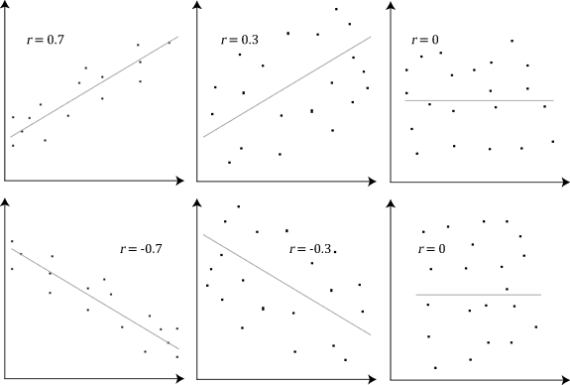
Analytical Significance
Pearson Correlation
Our team wanted to test the statistical significance of the variables within the joined table and based on the results of the Pearson Test their correlation was determined to be minimal. This means that each of the factors played a minimal role in the calculation of the overall Economic Freedom Score for each country. There must be other factors that contributed more heavily to this calculation
- Project II Pearsons Correlation: -.021
* Note: All code can be referenced in the jupyter notebook that will be provided for reference

Slide 9

Conclusion and Project II Results
Scope of Problem: once the data was decided upon and extracted, we cleaned the data then chose the best practice of analyzing the two sources
Analysis: research and planning was necessary into find data sets. Each Data set needed to be cleaned with different methods prior to being able to work with them in PgAdmin. Then we chose to analyze the data by creating visualizations and doing a correlation between the two main variables
Results: the correlation between our variables ended up being insignificant. However, we were able to find reputable data sets, extract the data into jupyter notebook, create data frames, clean them sufficiently to pull the data necessary for analysis, then create tables and push the information to pgadmin through the process of etl which was the main objective of this project.

